Slide 1
Exploring the Rotating Calipers Algorithm for Smallest Bounding Box Calculation

Slide 2
01
Introduction
02
Background
03
Algorithm Overview
04
Uses in real life
05
Explaining the code
06
Complexity performance
07
Conclusion

Slide 3
01 Introduction
The classic problem of identifying the tiniest bounding box for a convex polygon is one that has practical applications across numerous different fields, particularly in computational geometry. Many smart algorithms have been developed such as the rotating calipers algorithm to meaningfully tackle this challenge by analyzing pairs of edges on a polyhedral surface and determine their role within minimizing overall size requirements until complete agreement about optimal configuration. The problem of finding the smallest bounding box for a convex polygon holds significant importance in computational geometry, logistics, and various related fields due to its versatility and practical applications.

Slide 4
02
Background
x
y

Slide 5
The intersection between computer science and mathematics is where computational geometry thrives, which involves the exploration of algorithms and data structures for solving geometric challenges. Geometric entities such as points, lines, polygons or multi-dimensional shapes are frequently utilized to address these issues. The application of computational geometry spans numerous fields including robotics, image processing or geographic information systems in addition to areas like computer graphics and aided design techniques that have been developed by researchers exploring this realm over time. Some key concepts in computational geometry are geometric primitives, convex hulls, Voronoi diagrams and Delauney triangulation.

Slide 6
03
Algorithm overview
404 NOT FOUND
The rotating calipers algorithm explores the concept of rotating a pair of calipers around the convex hull of the polygon while maintaining parallelism to the edges.

Slide 7
Steps of the algorithm
Convex Hull
construction
Initialization
Compute perpendicular distances
Iteration
Update minimum perimeter
Final result

Slide 8
04
Uses in real life

Slide 9
Robotics
Game development
AR & VR
Efficient movement around barriers
For collision detection
Accurate object placement and interaction

Slide 10
05
Explaining the code

Slide 11
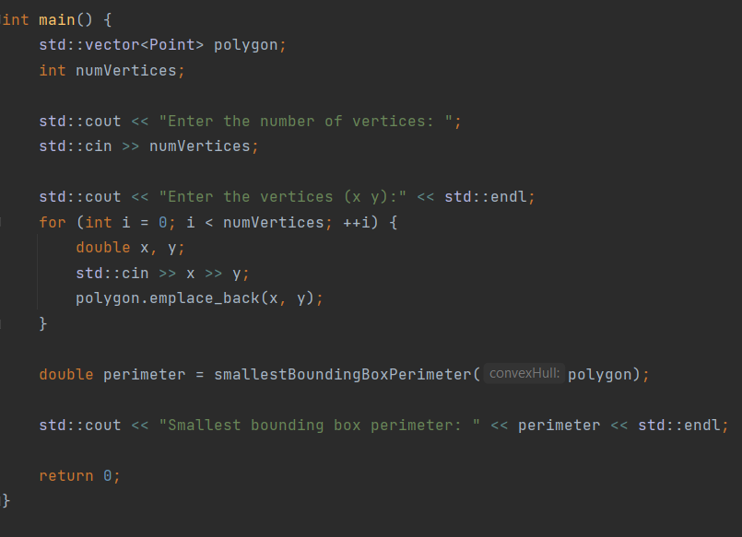
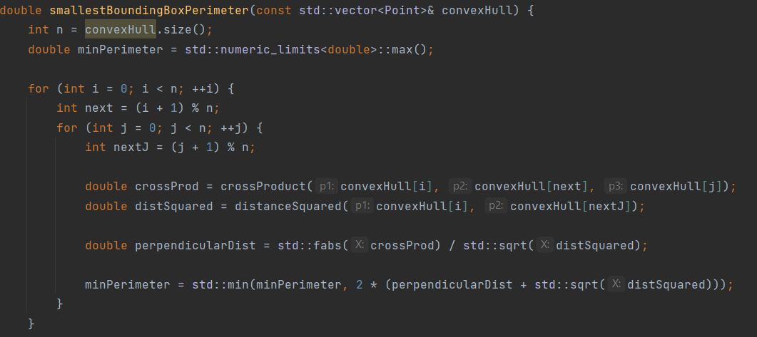
crossProduct
smallBBPerim
Main
Computes the cross product of vectors
Implements rotating calipers algorithm
Initializes a polygon

Slide 12
06
Conclusion
The significance of the rotating calipers algorithm lies in its ability to efficiently
and effectively determine the smallest bounding box for a convex polygon, making
it an adaptable solution across multiple practical applications. Its simplicity
and versatility make it an indispensable tool within computational geometry and
related industries such as logistics, manufacturing, robotics, or computer graphics.
Ultimately improving process optimization while enhancing geometric data
representation accuracy.

Slide 13
Thank you for your attention!
Visovan Catalin, Year II

